Slide 1
Azure DevOps & AzureSQL: Practical Guide for Database Development & Standards

Slide 2


Azure DevOps & AzureSQL: Practical Guide for Database Development & Standards
Carlos Lopez
Cloud Data Architect
Microsoft MVP Data Platform

Slide 3




Carlos
López
Cloud Data Architect
Microsoft MVP Data Plaform
Community Work:
Blogger, Speaker, Azure Data Tech group leader, SQL Saturday Board member
carlos-lopez-taks
@carloslopezswf
www.muppity.net

Slide 4
Agenda
Azure DevOps and SQL Fluff overview
Azure DevOps streamlined process
Enforcing SQL code standards SQL Fluff
Integrating SQL Fluff with Azure DevOps
Continuous Integration & Deployment (CI/CD) for Databases
Monitoring Code Quality & Compliance
Quick tips on branch management, code review
Recap of key points and next steps for implementing these tools

Slide 5
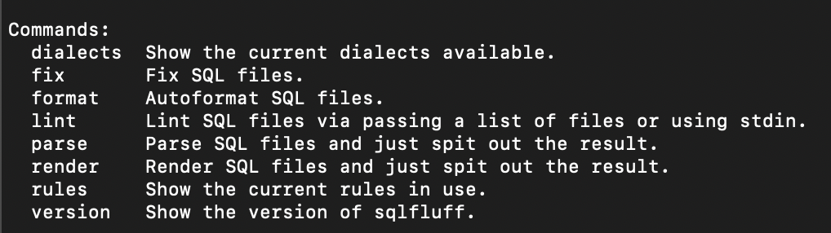
SQL Fluff overview
SQLFluff CLI commands:
lint -- Gives suggestions how to improve SQL code
fix -- Fix formatting issues in the code. This is a lot more useful especially, if one wants to format hundreds of files
parse -- show how SQLFluff interprets the SQL statement, very useful for debugging behavior
Notes:
SQLFluff is written in Python it is a small command line application that can do several things:

Slide 6













SQL Linter Dialects

Slide 7
SQLFluff configuration
Look for config file for SQLFluff (.sqlfluff) which works well for tsql

Slide 8
SQL Fluff Example to get started

Slide 9
Azure DevOps and SQL Fluff overview
Brief overview of Azure DevOps and SQL Fluff
How Azure DevOps supports streamlined deployment to Azure SQL

Slide 10
Azure DevOps and SQL Fluff overview
Linting is a process where a code analyzer is run to find programmatic errors
SQL Fluff is a Python small app
Notes:
Linting is a process where a code analyzer is run to find programmatic errors, bugs, “stylistic constructs” or anti-patterns. For example, in Python there are specific modules that help you with linting when the code is build. If the code is not indented correctly (or whatever rule your code has to obey in Python), the line is flagged in the build. Depending on the implementation, the build gives a warning, or if they’re really strict, the build fails.

Slide 11
Azure DevOps streamlined process

Slide 12
Azure DevOps and SQL Fluff standards
SQL Fluff Introduction
Overview of SQL Fluff and its benefits in enforcing SQL code standards
Why it’s essential for database projects

Slide 13
Enforcing SQL code standards SQL Fluff
Naming Conventions
Formatting
Commenting
Joins
Avoid Cursors (When Possible)
Avoid Scalar UDFs in SELECT Clause
Use SARGable Queries
SET NOCOUNT ON
Use Appropriate Data Types
Allow Use of Query Hints WITH (NOLOCK) Sparingly

Slide 14
Integrating SQL Fluff with Azure DevOps

Slide 15
Continuous Integration & Deployment (CI/CD) for Databases
Automating testing and deployment of database schema changes
Brief walkthrough of setting up a CI/CD pipeline for database projects

Slide 16
Continuous Integration & Deployment (CI/CD) for Databases

Slide 17
Continuous Integration & Deployment (CI/CD) for Databases

Slide 18
Monitoring Code Quality & Compliance
Using Azure DevOps dashboards to track SQL code quality
Key metrics to monitor (code coverage, duplication)

Slide 19
Monitoring Code Quality & Compliance

Slide 20
Best Practices
Quick tips on branch management, code review, and collaboration
Key strategies to optimize team efficiency

Slide 21
Quick tips on branch management, code review

Slide 22
Recap of key points and next steps for implementing

Slide 25
Carlos López
Azure DevOps & AzureSQL: Practical Guide for Database Development & Standards
carlos-lopez-taks
@carloslopezswf
www.muppity.net

